Slide 1
REVIEW OF THE ACADEMIC YEAR
( 2009-10)
Positive thinking leads to positive actions – and consequently positive results. Optimism is a person’s passport to a better tomorrow.– Shammi Sukh

Slide 2
No .of working days
179
No. of teachers 32
No. of students
687

Slide 3
Thrust Areas
80%Class average in Maths ,English , Science
Obtaining good results in common exam
Club activities
Standard Question Papers
Balancing academic and co-curricular activities

Slide 4
Academic Supervisor
Guiding, appraising, planning and overseeing day to day work.
Counseling, framing new projects and look into the
Class and Examination Co-ordinator
Guiding team members on information communicated by the supervisor on assemblies, Procedures to be followed by the class teacher in regard to classroom management skills, discipline, homework schedule, tests ,exams etc.
Admin work

Slide 5
Styles used to enhance the teaching and learning process
Group
activities
Peer evaluation
Use of IT (you tube films and PowerPoint)
Peer-mentoring

Slide 6
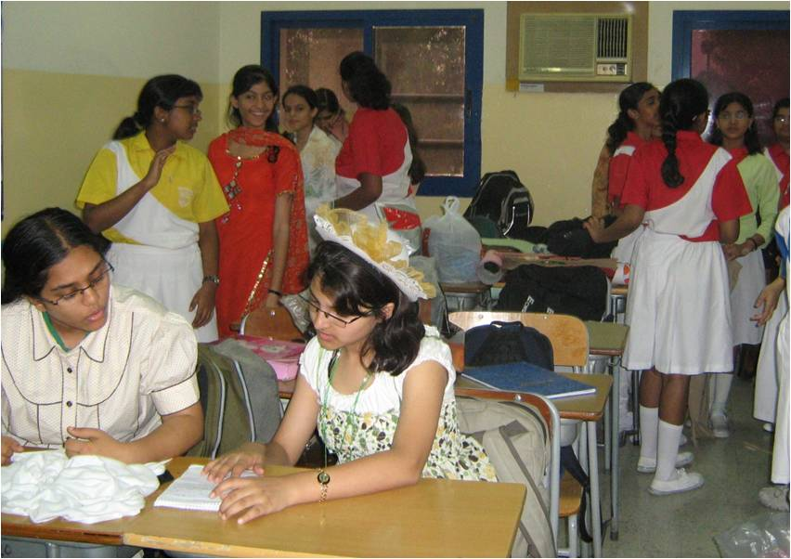
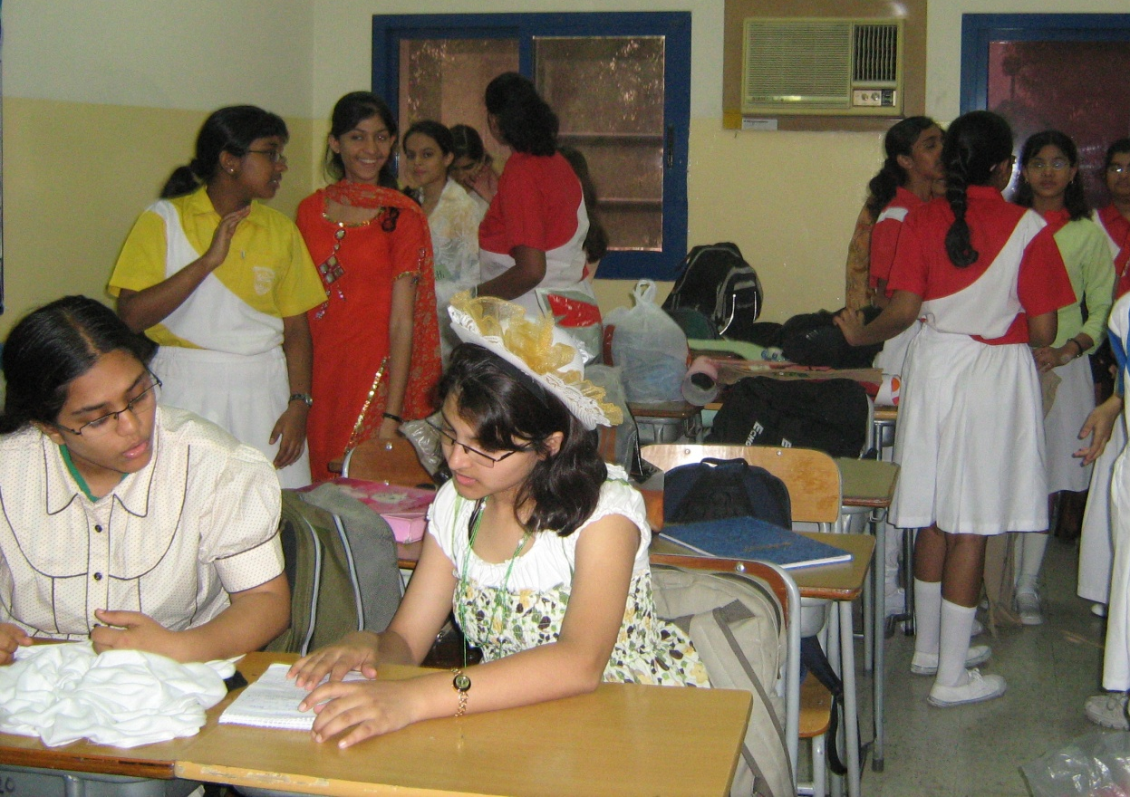
back

Slide 7
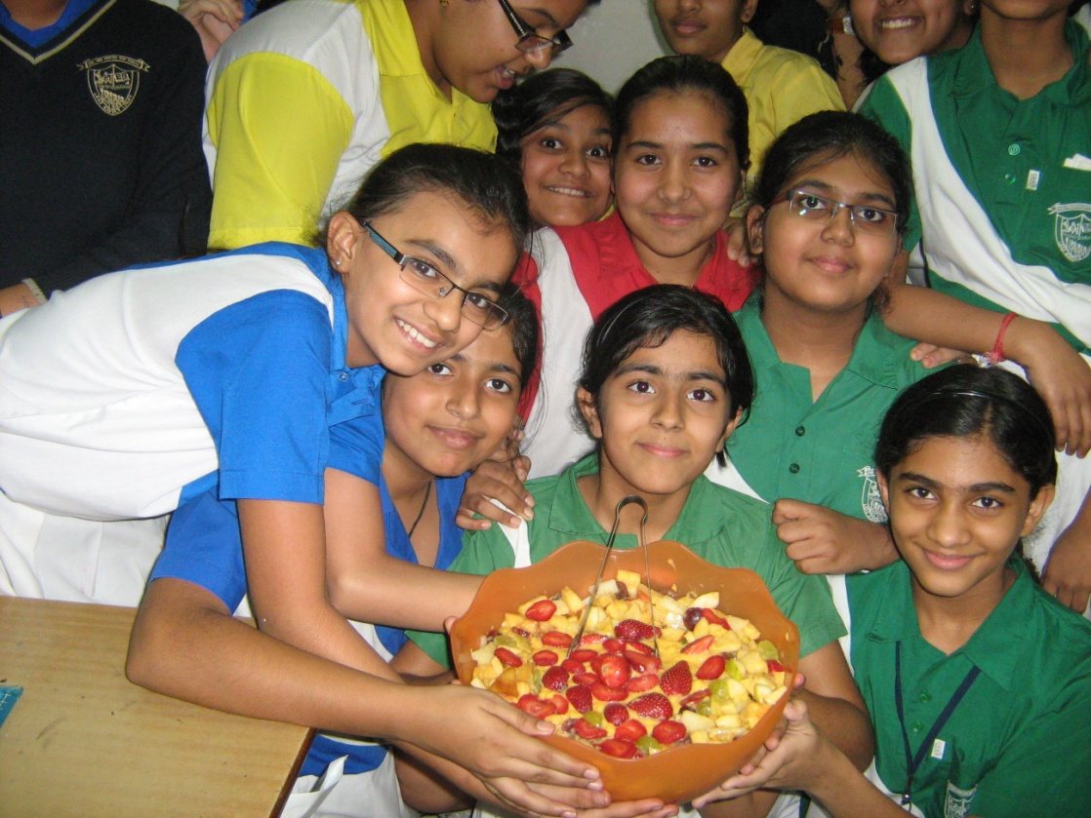
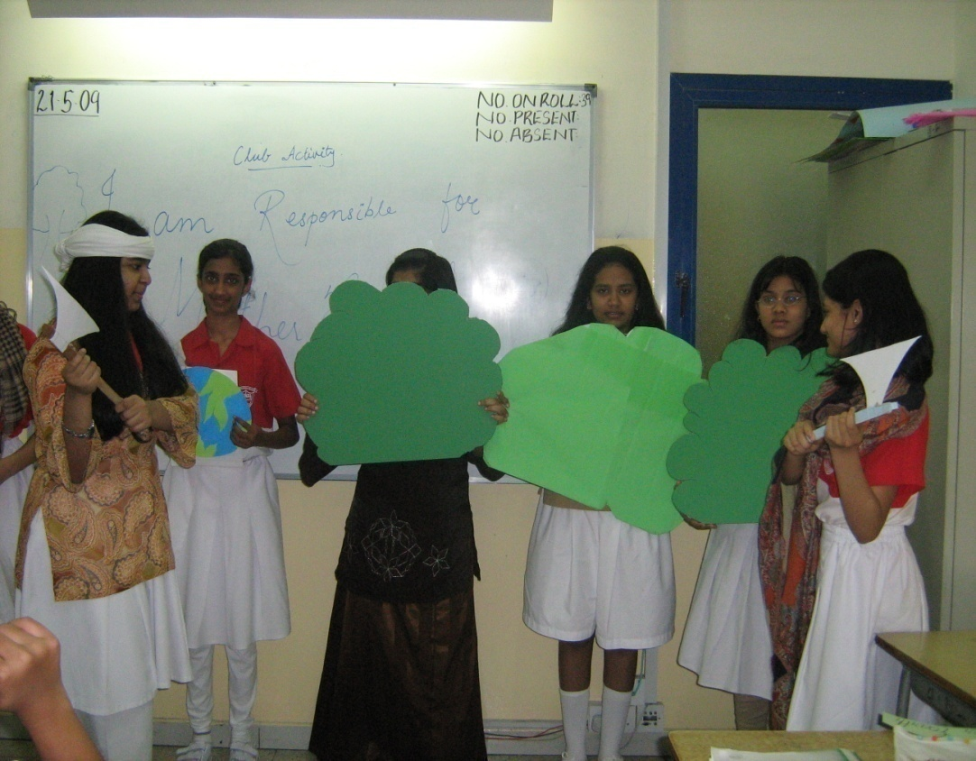
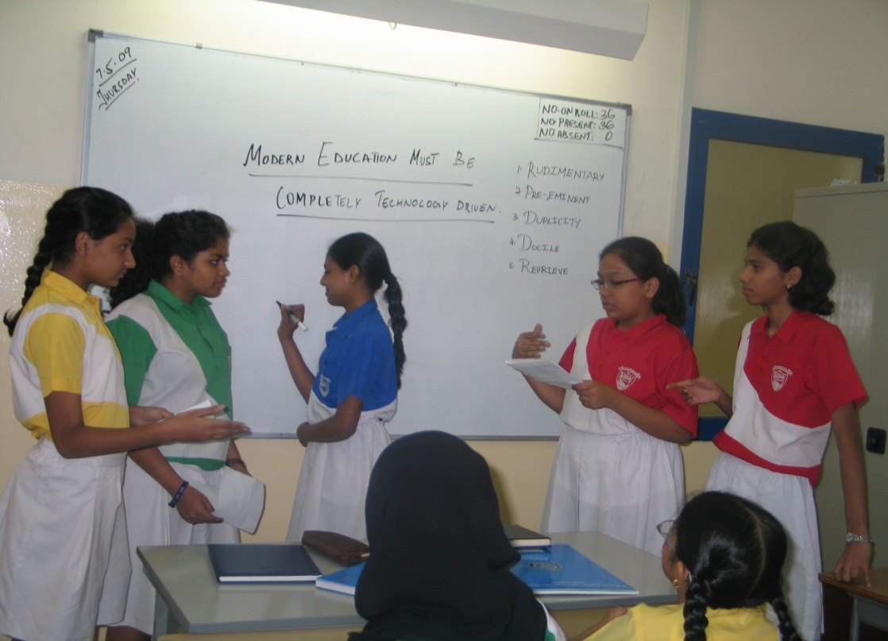
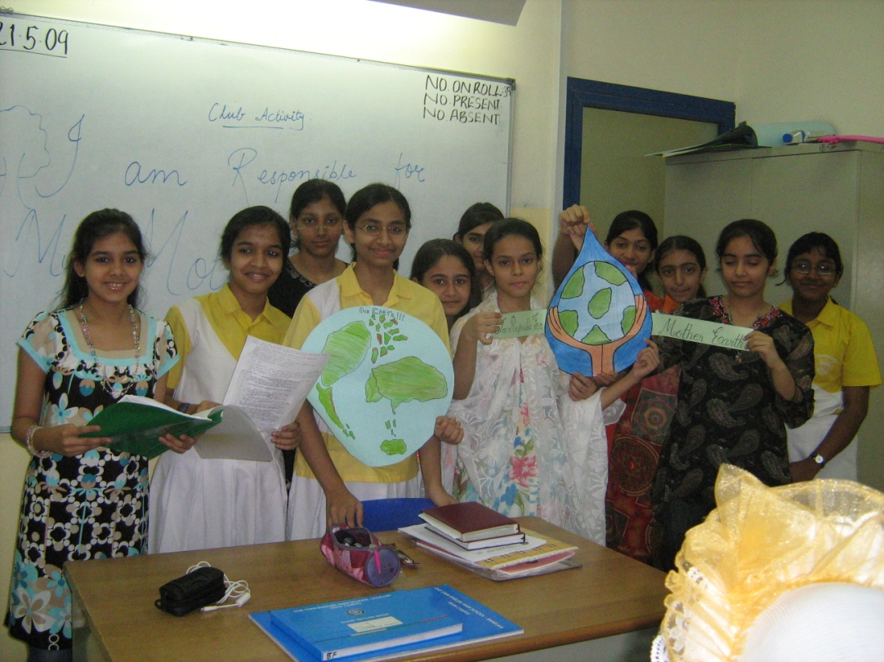
back

Slide 8
BRINGING OUT THE BEST
Intra-Activities
English Week, 2nd Language week, Qirat Competition, Club activities, I- donate – a- book campaign, Swaralaya,
Maths Quiz.
Inter-school Activities
Jhankaar
Eco-Club Activities
Save water and electricity.
Relish food Refrain Waste.
Short story writing ( scheduled date April 15th)

Slide 9
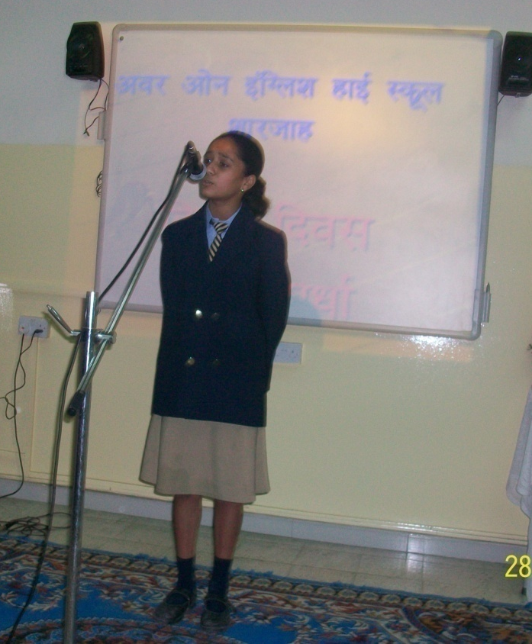
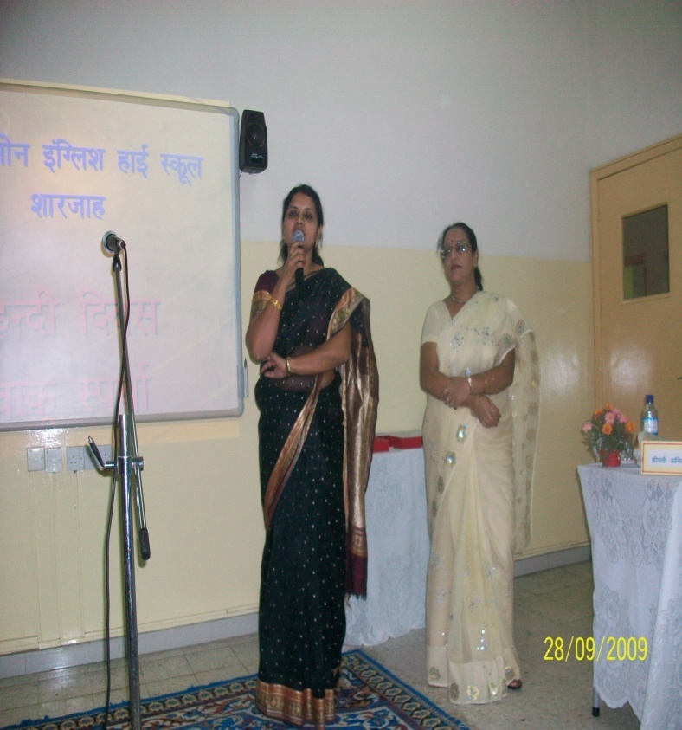
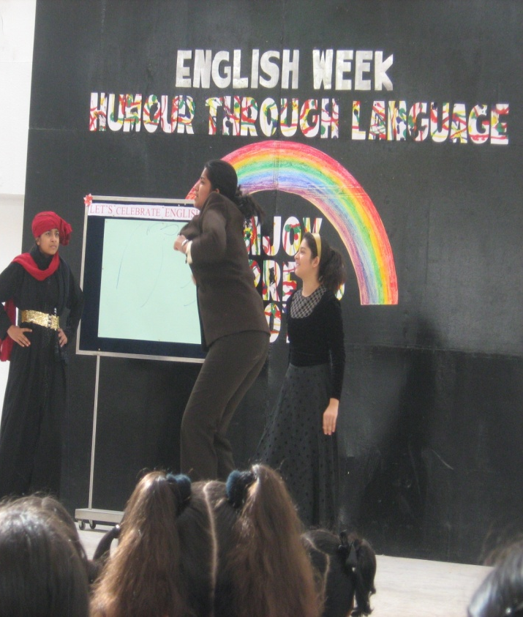
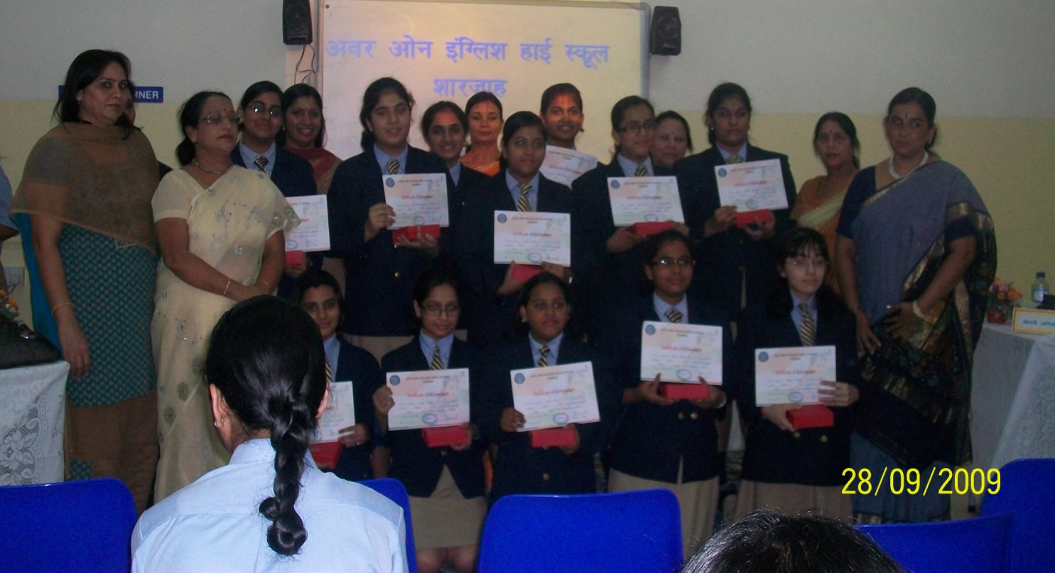
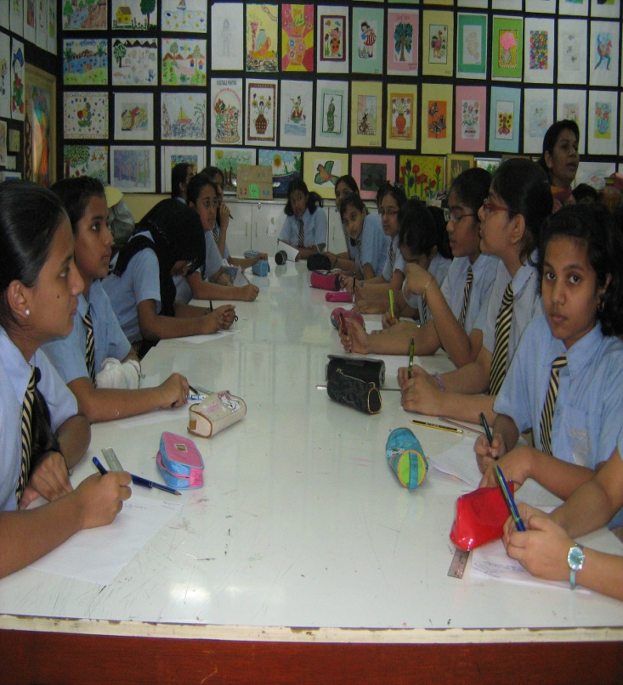

Slide 10
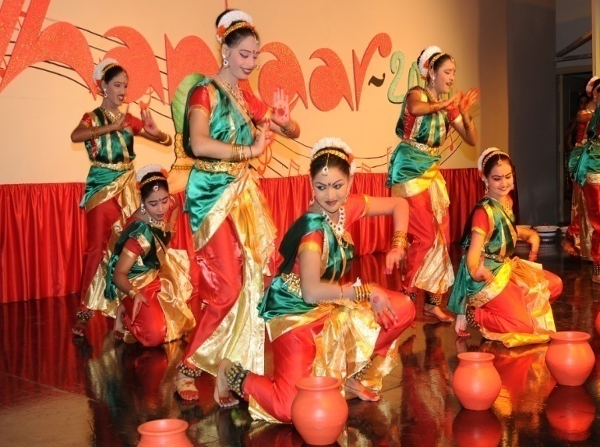
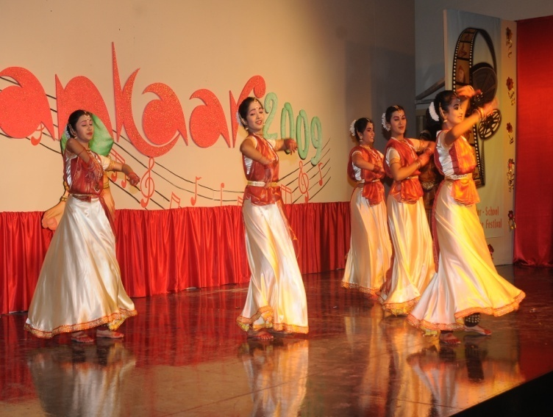
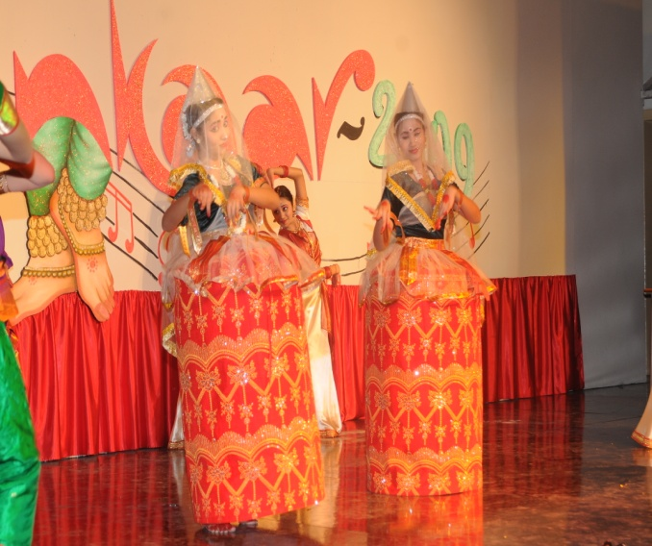
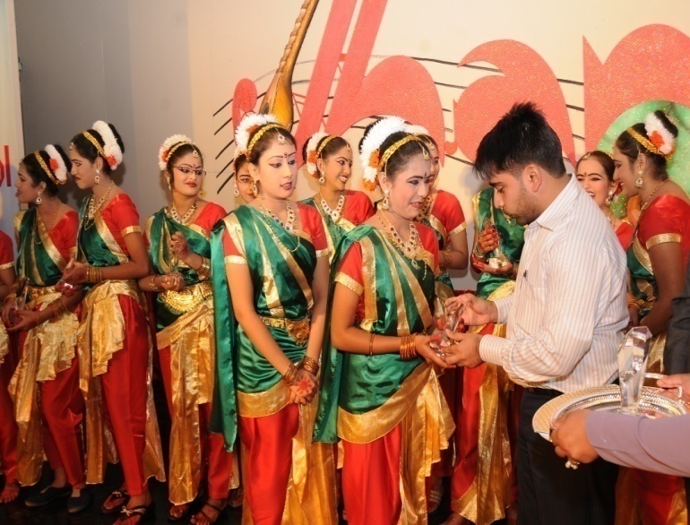
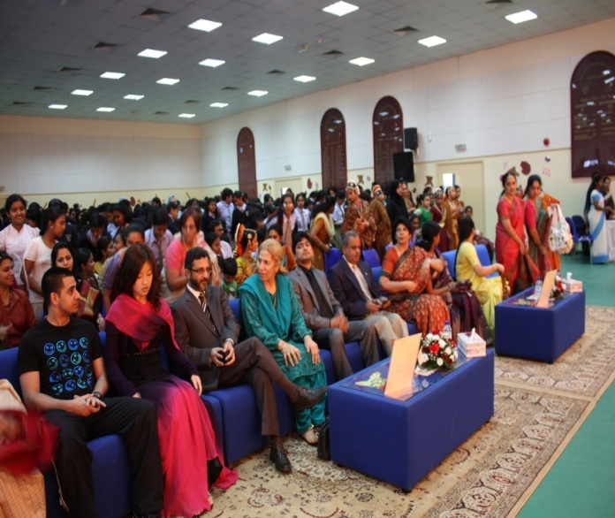
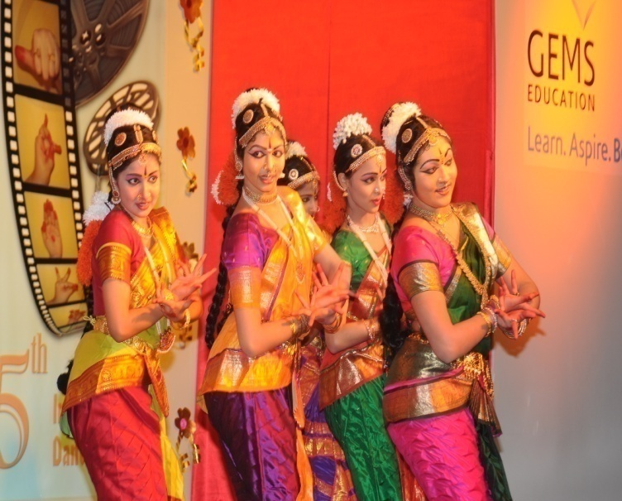
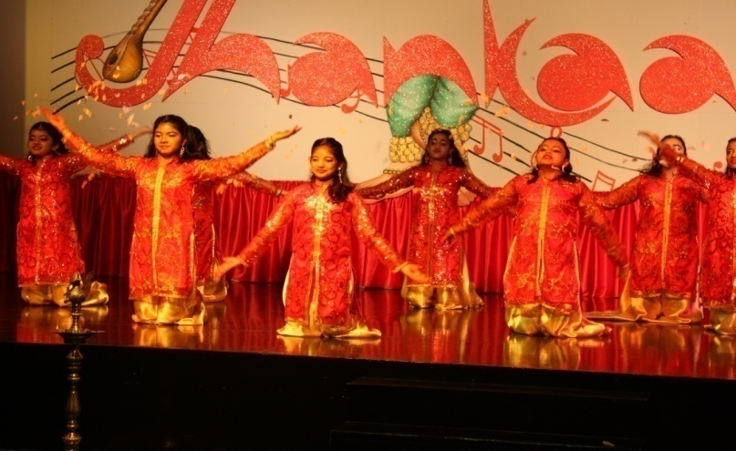
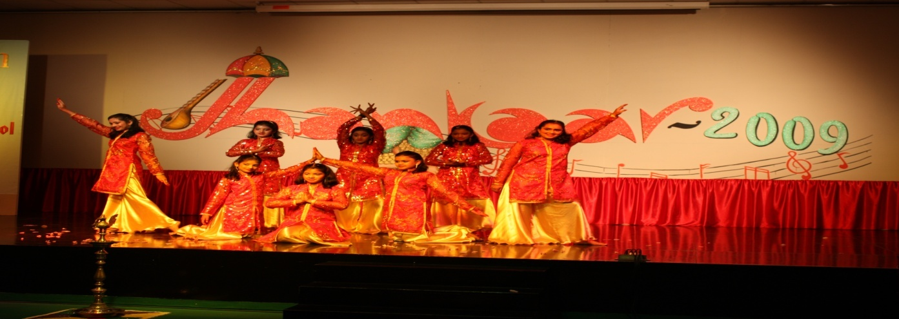

Slide 11
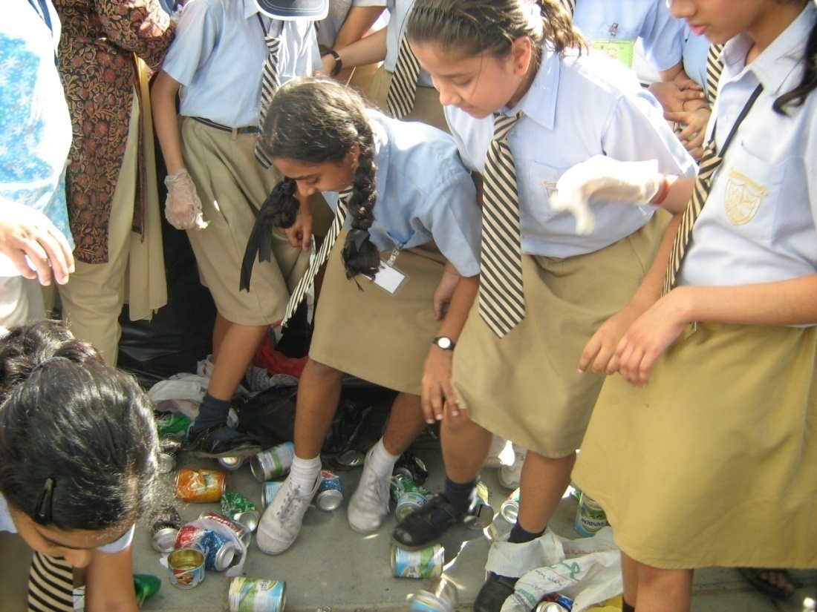
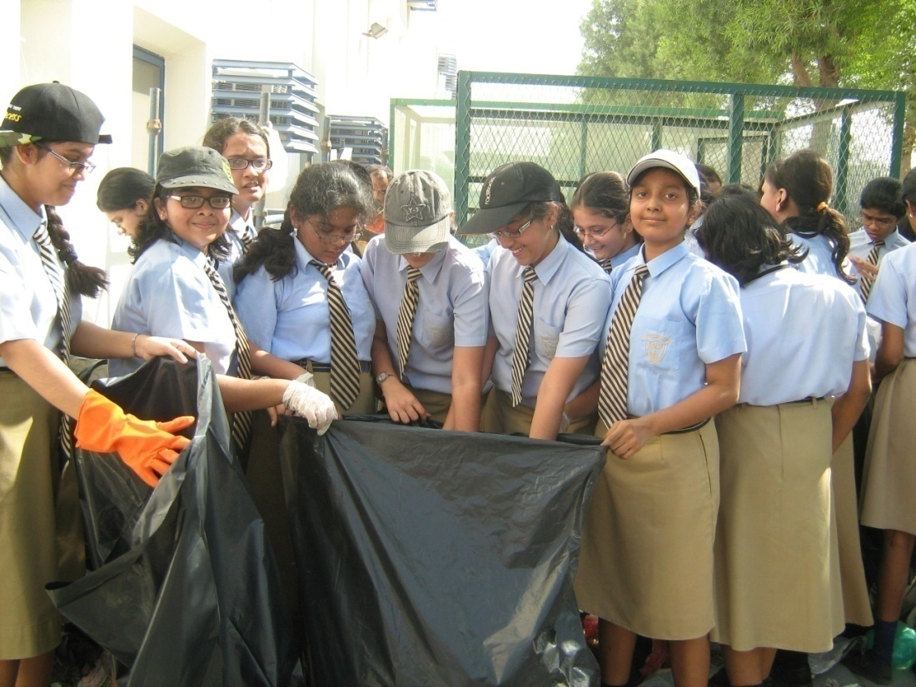
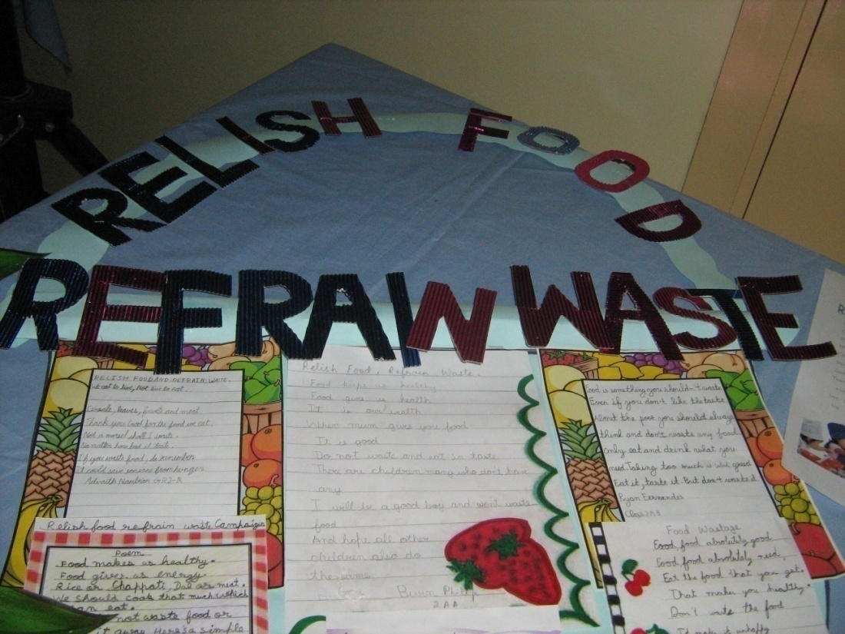
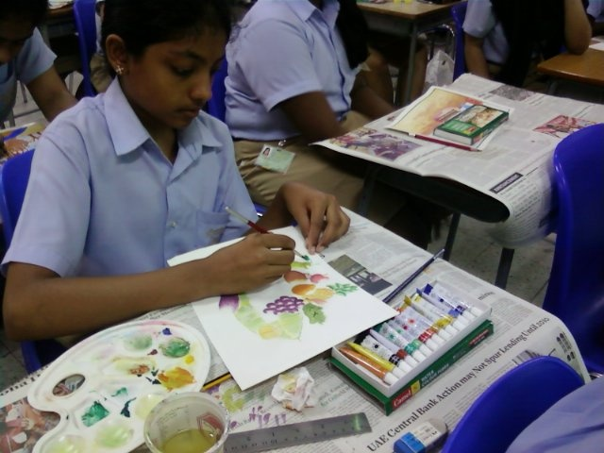

Slide 12
RESULT
ANALYSIS
Grade 7
Grade 8
ENGLISH
MATHS
SCIENCE
Social studies

Slide 15

What was the percentage of English in the First Term ?
62.3
61
63.5

Slide 16
Percentage in English
61

Slide 17
WRONG

Slide 18
62.3%

Slide 19

YOU ARE RIGHT WELL DONE !

Slide 20
Concerns
Grade 7
Retest =35
Detainees=4
Grade 8
Retest=32
Detainees =4

Slide 21
Suggestions For The New Academic Year 2010-11
Integrating technology in teaching and testing.
(TPCK approach)
Reviewing the behavior
Management
system
Learning and adapting to the needs of the 21st century students.

Slide 22
School didn’t teach me to read--I learnt from my Games.-A student

